Slide 1
AWS & Generative AI Fundamentals

Slide 2
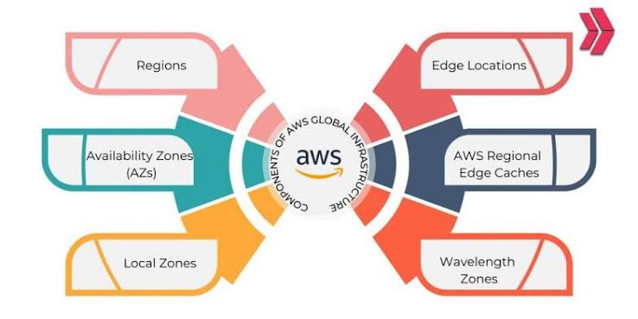
AWS GLOBAL INFRASTRUCTURE – REGIONS

Slide 3
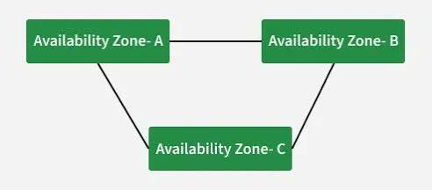
AWS GLOBAL – AVAILABILITY ZONES

Slide 4

AWS Global Infrastructure – IAM

Slide 5
THANKS FOR WATCHING

